Slide 1

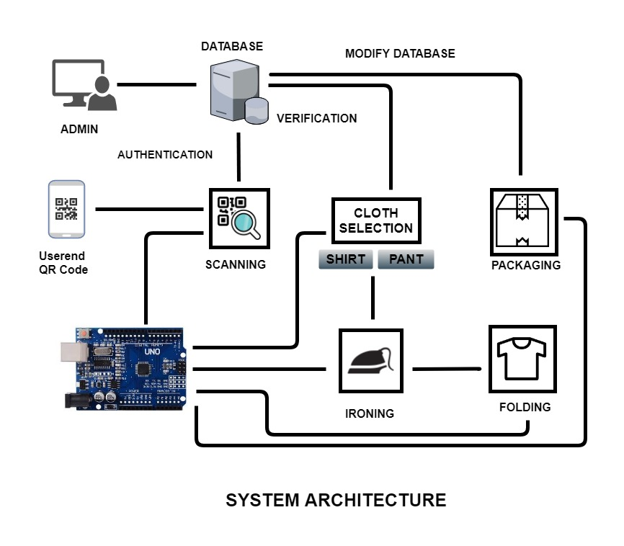
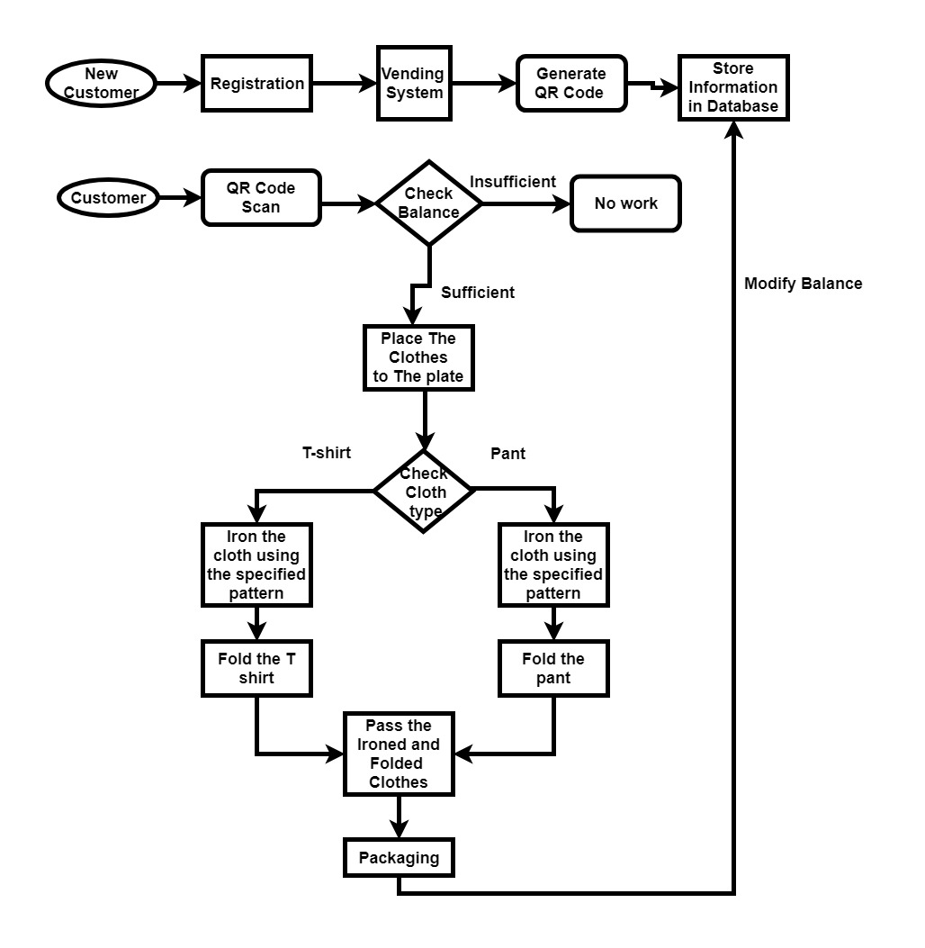
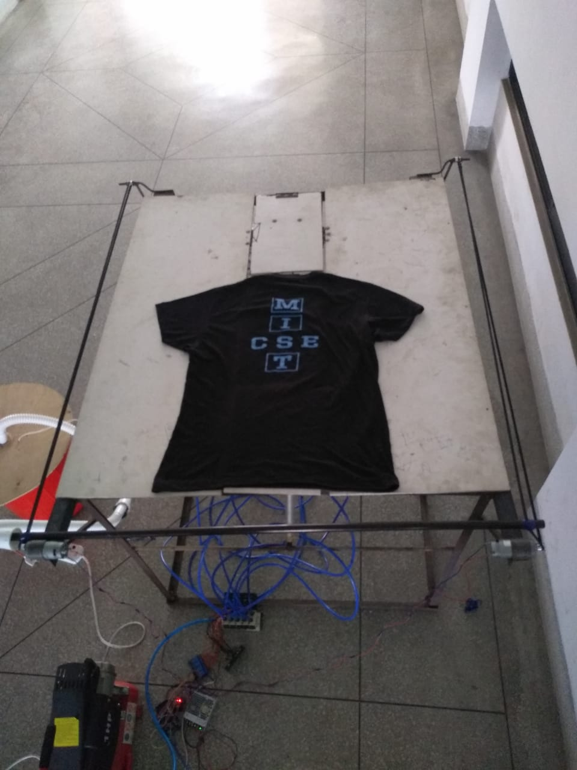
Automatic Laundry System
Fardin Momtaj, MD Umair Sifat, Imtiaz Ahmed, SM Arif Ahmed, Farhan Saif Chowdhury
Department of Computer Science and Engineering
Military Institute of Science and Technology
ABSTRACT
SYSTEM ARCHITECTURE
WORKFLOW DIAGRAM
PROTOTYPE
Today in our modern world we have various types of technology to make our everyday life easier. We have washing machine for clothes, vacuum cleaners for cleaning, refrigerators for cooling and in some cases, even cooking machines. In a civilized society everyone wants to look attractive. As a part of attractive appearance one of the most important thing is our cloth. To manage our cloths we have to do ironing, folding and packaging of our cloths. Automatic Laundry System is a smart solution for this tasks. It uses an innovative way to do ironing, folding and packaging of various cloths by minimizing the difficulties of doing the tasks. It is an automated machine which does ironing, folding and packaging of cloths by just placing the cloth on the tray and giving some necessary command. It also includes vending mechanism and mobile application facility both from user side and admin side.
DISCUSSION
INTRODUCTION
To compete with the modern technologies that are making our life easier, automatic laundry system can be one of them. It can reduce the hustle of processing and managing cloth effectively. As it automates the complete system there will not be any human effort only for doing a specific job. User can directly interact with the system so that he/she can process the cloth by himself/herself. As the billing system is also automated there will not be any hustle of physical transaction. As it is a prototype of the actual system it has some accuracy issue. Though we have planned to make a ios version of the application, at present it can only be used by android user.
To make ironing, folding and packaging easier and for saving time an automatic laundry system has been designed. In automatic laundry system ironing, folding and packaging have been integrated for cloths as well as a vending mechanism and mobile application for the user. Vending machine will scan a QR code which will be created by application. The QR code will contain the necessary user information as well as the balance information. Then it will check in the database for authentication and verification. A payment system will be included so that it can used in the industry. The whole system will be considered as a single automated system where the user will only place the cloth in the tray and the user will get the cloth in a packet with a proper ironing.
COST ANALYSIS
SYSTEM FEATURES
Prototype
Pneumatic Cylinder | 10000
Air Compressor | 5300
Solenoid Valve | 3000
Solenoid Valve Base | 2000
Rod Frame | 6000
Raspberry Pi | 4000
Camera Module | 1500
PVC Board | 1000
Gear Motor | 700
CNC belt | 1000
Wooden Frame | 800
Heater | 1000
Arduino Mega 2560 | 750
Others | 10950
Total | 48000
Real Time
Pneumatic Cylinder | 10000
Air Compressor | 8000
Solenoid Valve | 3000
Solenoid Valve Base | 2000
Rod Frame | 6000
Raspberry Pi | 4000
Camera Module | 3500
PVC Board | 1000
Gear Motor | 2000
CNC belt | 2000
Wooden Frame | 1500
Heater | 1000
Arduino Mega 2560 | 750
Others | 15000
Total | 59750
Automatic ironing system.
Automatic folding system.
Automatic packaging system.
Vending mechanism.
Payment system.
User mobile application.
System admin application.
Maintaining database
REFERENCES
FUTURE EXPANSION
[1] Kaushik, Aman Mishra, Aakash Singh, Harsh , B.Hemalatha. (2014).Automatic Ironing Machine. Asian Academic Research of Multidisciplinary.1. 268.
[2] Y. Liu, K. Wang, D. Tran, Cloth Folding Machine. Internet:https://openscholarship.wustl.edu/cgi/viewcontent.cgi?article=1089context=mems411 , Oct. 10,2017
[3] T. Selker, P. Alto, G. Rozov, Fabric article folding machine and method,United States Patent US8973792B1, Nov. 14,2012
[4] T. Naidoo, Automatic Ironing Machine, United States Patent US4980981A, May 29, 1998
OBJECTIVE
Make the laundry system automatic integrated with ironing, folding and packaging.
Reduce the time it takes to do the task manually by human being.
Design a cost effective way to do this automatic system.
Web application to remove the platform dependency
Admin application to control the system and data.
Automatic packet placement where there will be roller to place the packet.
Convert the complete system in PLC for efficient performance.
IOS version of user application.

